Slide 1
Python
Session – 10
Date – 06th June, 2022

Slide 2
Decorators in Python
Decorators are a very powerful and useful tool in Python since it allows programmers to modify the behaviour of function or class. Decorators allow us to wrap another function in order to extend the behaviour of the wrapped function, without permanently modifying it. But before diving deep into decorators let us understand some concepts that will come in handy in learning the decorators.
First Class Objects
In Python, functions are first class objects that mean that functions in Python can be used or passed as arguments.
Properties of first class functions:
A function is an instance of the Object type.
You can store the function in a variable.
You can pass the function as a parameter to another function.
You can return the function from a function.
You can store them in data structures such as hash tables, lists, …

Slide 3
Decorators in Python
Consider the below examples for better understanding.
Example 1: Treating the functions as objects.
# Python program to illustrate functions
# can be treated as objects
def shout(text):
return text.upper()
print(shout('Hello'))
yell = shout
print(yell('Hello'))
In the above example, we have assigned the function shout to a variable. This will not call the function instead it takes the function object referenced by a shout and creates a second name pointing to it, yell.

Slide 4
Decorators in Python
Example 2: Passing the function as an argument
# Python program to illustrate functions
# can be passed as arguments to other functions
def shout(text):
return text.upper()
def whisper(text):
return text.lower()
def greet(func):
# storing the function in a variable
greeting = func("""Hi, I am created by a function passed as an argument.""")
print (greeting)
greet(shout)
greet(whisper)
In the above example, the greet function takes another function as a parameter (shout and whisper in this case). The function passed as an argument is then called inside the function greet.

Slide 5
Decorators in Python
Example 3: Returning functions from another function.
# Python program to illustrate functions
# Functions can return another function
def create_adder(x):
def adder(y):
return x+y
return adder
add_15 = create_adder(15)
print(add_15(10))
In the above example, we have created a function inside of another function and then have returned the function created inside. The above three examples depict the important concepts that are needed to understand decorators. After going through them let us now dive deep into decorators.

Slide 6
Decorators
As stated above the decorators are used to modify the behaviour of function or class. In Decorators, functions are taken as the argument into another function and then called inside the wrapper function.
Syntax for Decorator:
@h_decorator
def hello_decorator():
print(“Hello")
'''Above code is equivalent to –
def hello_decorator():
print(“Hello")
hello_decorator = h_decorator(hello_decorator)'''
In the above code, gfg_decorator is a callable function, will add some code on the top of some another callable function, hello_decorator function and return the wrapper function.

Slide 7
Decorator can modify the behaviour:
# defining a decorator
def hello_decorator(func):
# inner1 is a Wrapper function in
# which the argument is called
# inner function can access the outer local
# functions like in this case "func"
def inner1():
print("Hello, this is before function execution")
# calling the actual function now
# inside the wrapper function.
func()
print("This is after function execution")
return inner1
# defining a function, to be called inside wrapper
def function_to_be_used():
print("This is inside the function !!")
# passing 'function_to_be_used' inside the
# decorator to control its behaviour
function_to_be_used = hello_decorator(function_to_be_used)
# calling the function
function_to_be_used()

Slide 8
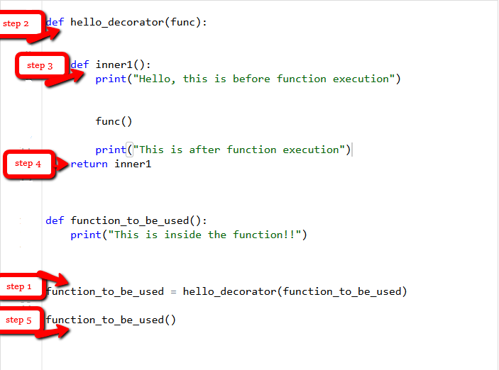
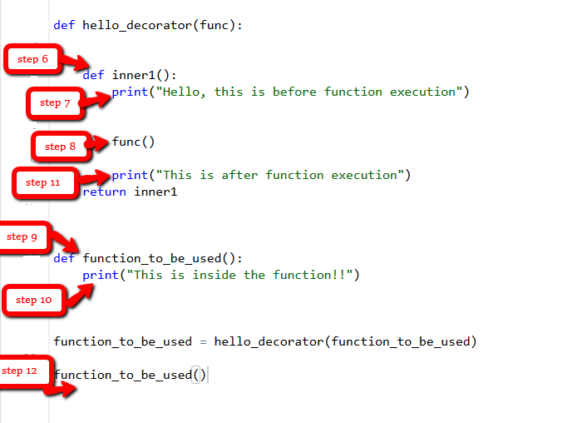
Decorator can modify the behaviour:
Let’s see the behaviour of the above code how it runs step by step when the “function_to_be_used” is called.

Slide 9
Decorator can modify the behaviour:
Let’s jump to another example where we can easily find out the execution time of a function using a decorator. # importing libraries
import time
import math
# decorator to calculate duration
# taken by any function.
def calculate_time(func):
# added arguments inside the inner1,
# if function takes any arguments,
# can be added like this.
def inner1(*args, **kwargs):
# storing time before function execution
begin = time.time()
func(*args, **kwargs)
# storing time after function execution
end = time.time()
print("Total time taken in : ", func.__name__, end - begin)
return inner1
# this can be added to any function present,
# in this case to calculate a factorial
@calculate_time
def factorial(num):
# sleep 2 seconds because it takes very less time
# so that you can see the actual difference
time.sleep(2)
print(math.factorial(num))
# calling the function.
factorial(10)

Slide 10
What if a function returns something or an argument is passed to the function?
In all the above examples the functions didn’t return anything so there wasn’t any issue, but one may need the returned value.
def hello_decorator(func):
def inner1(*args, **kwargs):
print("before Execution")
# getting the returned value
returned_value = func(*args, **kwargs)
print("after Execution")
# returning the value to the original frame
return returned_value
return inner1
# adding decorator to the function
@hello_decorator
def sum_two_numbers(a, b):
print("Inside the function")
return a + b
a, b = 1, 2
# getting the value through return of the function
print("Sum =", sum_two_numbers(a, b))

Slide 11
What if a function returns something or an argument is passed to the function?
In the above example, you may notice a keen difference in the parameters of the inner function. The inner function takes the argument as *args and **kwargs which means that a tuple of positional arguments or a dictionary of keyword arguments can be passed of any length. This makes it a general decorator that can decorate a function having any number of arguments.

Slide 12
Chaining Decorators
In simpler terms chaining decorators means decorating a function with multiple decorators.
Chaining decorators means applying more than one decorator inside a function. Python allows us to implement more than one decorator to a function. It makes decorators useful for resuabale building blocks as it accumulates the several effects together. It is also knows as nested decorators in Python.
Example:
# code for testing decorator chaining
def decor1(func):
def inner():
x = func()
return x * x
return inner
def decor(func):
def inner():
x = func()
return 2 * x
return inner
@decor1
@decor
def num():
return 10
print(num())
The above example is similar to calling the function as –
decor1(decor(num))

Slide 13
Decorating functions with parameters
Let's have an example to understand the parameterized decorator function:
def divide(x,y):
print(x/y)
def outer_div(func):
def inner(x,y):
if(x<y):
x,y = y,x
return func(x,y)
return inner
divide1 = outer_div(divide)
divide1(2,4)

Slide 14
Syntactic Decorator
In the above program, we have decorated out_div() that is little bit bulky. Instead of using above method, Python allows to use decorator in easy way with @symbol. Sometimes it is called "pie" syntax.
def outer_div(func):
def inner(x,y):
if(x<y):
x,y = y,x
return func(x,y)
return inner
# syntax of generator
@outer_div
def divide(x,y):
print(x/y)

Slide 15
Reusing Decorator
We can reuse the decorator as well by recalling that decorator function. Let's make the decorator to its own module that can be used in many other functions. Creating a file called mod_decorator.py with the following code:
def do_twice(func):
def wrapper_do_twice():
func()
func()
return wrapper_do_twice
We can import mod_decorator.py in other file.
from mod_decorator import do_twice
@do_twice
def say_hello():
print("Hello There")
say_hello()

Slide 16
Python Decorator with Argument
We want to pass some arguments in function. Let's do it in following code:
from mod_decorator import do_twice
@do_twice
def display(name):
print(f"Hello {name}")
display()

Slide 17
Python Decorator with Argument
As we can see that, the function didn't accept the argument. Running this code raises an error. We can fix this error by using *args and **kwargs in the inner wrapper function. Modifying the decorator.py as follows:
def do_twice(func):
def wrapper_function(*args,**kwargs):
func(*args,**kwargs)
func(*args,**kwargs)
return wrapper_function
Now wrapper_function() can accept any number of argument and pass them on the function.
from mod_decorator import do_twice
@do_twice
def display(name):
print(f"Hello {name}")
display("John")

Slide 18
Returning Values from Decorated Functions
We can control the return type of the decorated function. The example is given below:
from decorator import do_twice
@do_twice
def return_greeting(name):
print("We are created greeting")
return f"Hi {name}"
hi_adam = return_greeting("Adam")

